Slide 1
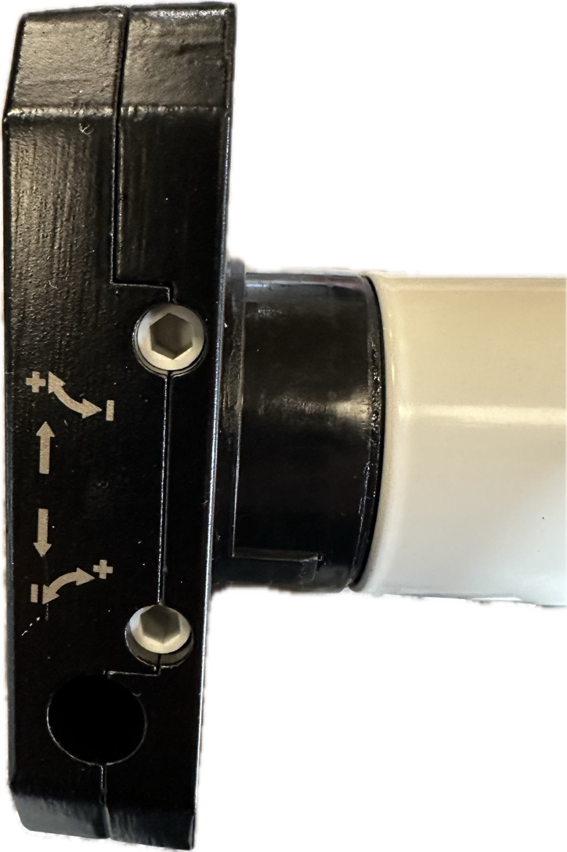
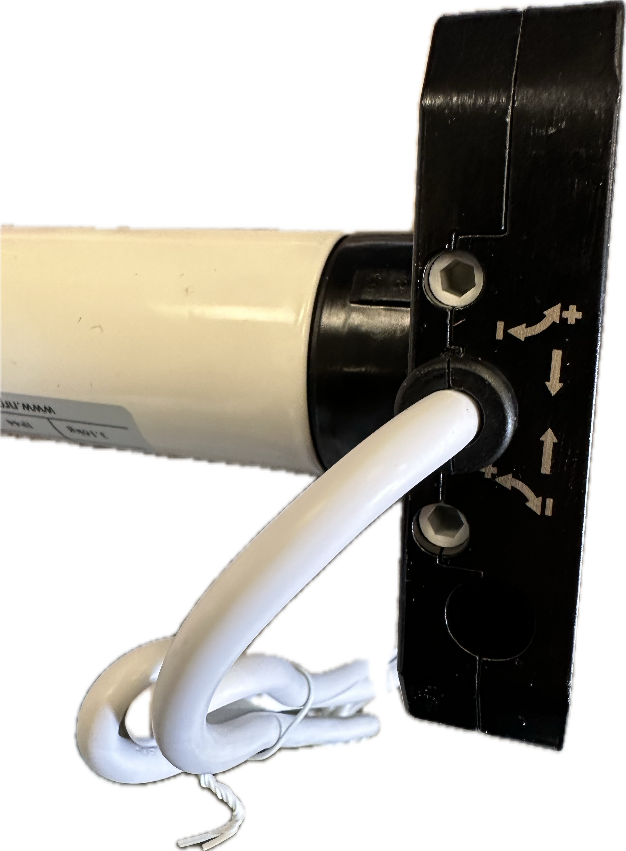
Setting the Top Limit
Left Hand Motor
Top is your DOWN limit
Bottom is your UP limit
Please note your motor will come with either:
White and white toggles
Using either a test lead or the up and down hold - to - run buttons inside the control panel.
Run the motor in the down direction until it stops. At this point attach the curtain via the straps provided unless already attached.
Run the motor up to the top leaving only the bottom piece of the door within the tracks. If the door does not stop at the top press the down button on the panel and the door will stop.
If the door doesn’t sit in the desired position within the opening follow the steps below.
To make the door sit higher in the guides.
+ the limit approx 5 times, then take the door down & back up again to check if it has moved, repeat until you get the curtain at the desired level.
To make the door sit lower in the guides.
- the limit approx 5 times, then take the door down & back up again to check if it has moved, repeat until you get the curtain at the desired level.
Right Hand Motor
Bottom is your DOWN limit
Top is your UP limit

Slide 2
Setting the Bottom Limit
Left Hand Motor
Top is your DOWN limit
Bottom is your UP limit
Using either a test lead or the up and down hold - to - run buttons inside the control panel.
Please note your motor will come with either:
White and white toggles
Run the motor in the down direction until it stops.
If the door doesn’t sit in the desired position within the opening follow the steps below.
To make the door sit higher in the guides.
- the limit approx 5 times, then take the door down & back up again to check if it has moved, repeat until you get the curtain at the desired level.
To make the door sit lower in the guides.
+ the limit approx 5 times, then take the door down & back up again to check if it has moved, repeat until you get the curtain at the desired level.
Right Hand Motor
Bottom is your DOWN limit
Top is your UP limit

